Slide 1
State Management
Jonathan Cheng & Sean Prendi

Slide 2
What is “state management”?
Recall React components (usually) have state.
State Management (our definition): The practice of “handling” pieces of state in a productive way.
Handling = passing, receiving, modifying, saving, fetching, pushing, waving it in the air (like you just don’t care)
Do we just figure it out as we go?
Remember the waterfall model of React state! Not as easy an endeavor as it may seem at first.

Slide 3
Why State Management?
Sometimes state is simple: { name = “Mr. Meeseeks” }
Sometimes it’s not as simple:
{
numMeeseeks = 5,
spawnMeeseeks = (name) => {/* code */},
mission = (goal) => {/* code */},
despawnMeeseeks = () => {/* some callback */}
}

Slide 4
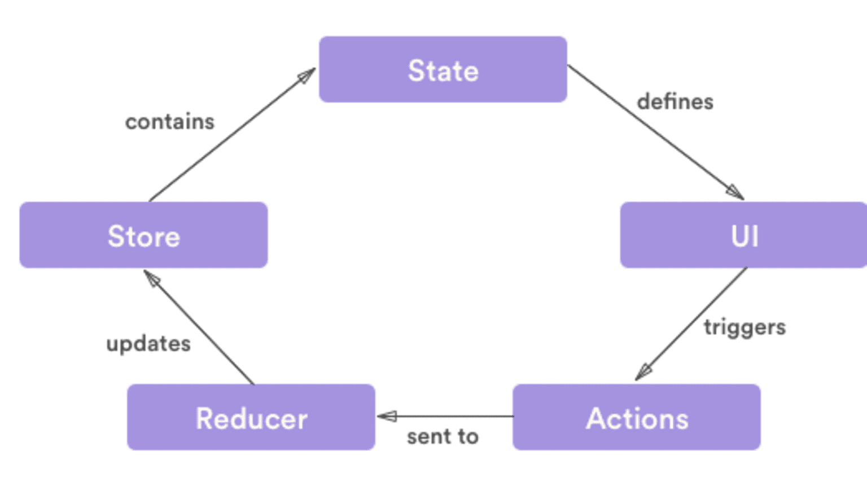
The Old Way
A Predictable State Container for JS Apps: REDUX
Not actually packaged/connected to React, though they are often paired together (very often).
Notes:
There are three building parts: actions, store, and reducers.

Slide 5
Actions (redux.js.org)
Payloads of information
Application --(data)-> action
{
type: "ADD_TODO",
payload: {text:"Hello Foo"}
}
“Action creator” = function that takes arguments and returns an action object (as above)

Slide 6
Reducers (redux.js.org)
const TODOReducer= (state = {}, action) => {
switch (action.type) {
case "ADD_TODO":
return {
...state,
...action.payload
};
default:
return state;
}
};
How does state change based on an action?
App --(data)--> action --> store --> new state

Slide 7
Store (redux.js.org)
Simply stores the application state
Looks like a JS object (or JSON)
{
A: val1,
B: val2,
...
}

Slide 8
The Old Way
A Predictable State Container for JS Apps: REDUX
Not actually packaged/connected to React, though they are often paired together (very often).

Slide 9
The Old Way
A Predictable State Container for JS Apps: REDUX
Not actually packaged/connected to React, though they are often paired together (very often).
OVERKILL

Slide 10
Useful, but
Redux is notoriously complicated to learn. Often it is unjustifiable to spend time+effort to use it for a startup-level (low-medium complexity) webapp.
Not for us mere mortals.
For Facebook, maybe...

Slide 11
Instead: EasyPeasy
ABSTRACTION of Redux!
Maintains the solid principles + concepts
No messy set up of action types, reducers, etc.
Very little boilerplate (esp. vs Redux)
Another layer of abstraction
3rd party (non-official React/Redux)
Smaller community

Slide 12
Links:
Official Site:
https://easy-peasy.now.sh/
They have great Quick Start docs.
Follow those and you’re golden!
Neat little article: (also has good step-by-step)
https://flaviocopes.com/react-easy-peasy/

